Slide 1

Pre-Owned Automobile Price Modeling for the India Market
Live Presentation by Pat Grinwald

Slide 2
Table of contents
01
02
03
04
Pre-Owned Market
Solution Approach
Achieving Fair Value and a Quick Sale
Analyze our data, build insights and systematically build an insightful predictive pricing model
Proposed Final Model
Recommendations
Results, Key Takeaways
Insights and Business Focus

Slide 3

01
The Pre-Owned Market
Achieving Fair Value and a Quick Sale

Slide 4

Problem Definition
Sellers in the India used car market who struggle to achieve a fair value for their cars can often face challenges in securing a quick sale.

Slide 5
Problem Definition - Costs of Keeping Cars too Long
Financial Costs:
Depreciation
Inventory Carrying Costs
Accrued interest on inventory
Opportunity
Operational Costs:
Marketing and Advertising
Sales Staff
Administrative Costs
Indirect Costs:
Reputation
Customer Satisfaction
Morale
Notes:
Financial Costs:
Depreciation: The value of a used car depreciates over time. The longer a car sits on the lot, the more its value decreases, potentially leading to a lower selling price or even a loss for the dealership.
Inventory Carrying Costs: These include expenses related to storing and maintaining the car on the lot, such as rent or mortgage payments for the lot space, insurance, security, utilities, and cleaning and detailing.
Financing Costs: If the dealership has financed the purchase of the used car, they continue to accrue interest charges until the car is sold.
Opportunity Costs: The capital tied up in a slow-moving car could be used to acquire other cars with higher turnover potential.
2. Operational Costs:
Marketing and Advertising Costs: The dealership may need to spend additional money on advertising and promotions to try to sell the car.
Sales Staff Time: The sales staff spends time and effort trying to sell the car, which could be allocated to other tasks or potential customers.
Administrative Costs: The dealership incurs costs related to managing the inventory, updating listings, and other administrative tasks associated with the unsold car.
3. Indirect Costs:
Loss of Reputation: A dealership with a reputation for having many older cars on the lot may be perceived as less desirable by customers.
Reduced Customer Satisfaction: Potential customers may be disappointed if they are unable to find newer or more desirable cars at the dealership.
Employee Morale: A lot full of slow-moving cars can affect the morale of sales staff and other employees.
In conclusion, keeping a car on the lot for too long can result in significant financial, operational, and indirect costs for used car dealerships. It is essential for them to adopt efficient inventory management practices, competitive pricing strategies, and effective marketing techniques to minimize these costs and maximize their profitability.
.

Slide 6
Pre-Owned Market Pricing Challenges
Competition: The used car market in India has become increasingly competitive.
Fair Market Value: Determining the fair market value of a used car can be challenging, especially given the lack of standardized pricing information.
Trust and transparency: Pricing disputes between buyers and sellers can lengthen sales cycles, making it difficult to maintain profitability and build customer confidence.
Inventory management: Managing inventory can be a challenge for used car dealerships. We generally want cars sold within 60 days to maintain profitability.
Shifting consumer preferences: Consumer preferences in the Indian car market are often changing. For example, a growing preference for newer models can make it difficult to sell older cars, which may have lower resale value.
Online platforms: The rise of online platforms has made it easier for buyers and sellers to connect directly, bypassing traditional dealerships. A an accurate pricing model is essential in attracting more buyers to the convenient buying experience.
Notes:
Competition: Both organized and unorganized players vying for market share. Organized players, such as online platforms and franchised dealerships, offer a wider range of services and greater transparency, making it difficult for smaller, independent dealerships to compete.
Pricing: Several factors, including mileage, brand, model, number of owners, age, etc. can influence the actual worth of a car. Not getting this right can lead to pricing disputes between buyers and sellers, lengthening the sales cycle and can make it difficult for dealerships to maintain profitability.
Trust and transparency: Building trust with customers is essential for any business, but it is particularly important in the used car market, where there is a history of fraud and misrepresentation. The prevalence of haggling and negotiation in the used car market can lead to prolonged sales cycles and sellers ultimately receiving less than the fair value for their car and erode customer confidence.
Inventory management:
There are large uncertainties in both pricing and supply.
0-30 days: This is considered a quick sale, and often indicates the car was priced competitively and in high demand.
30-60 days: This is still within the normal range for most dealerships. You may start to see price reductions around this time.
60-90 days: The car is now considered "aging inventory." You're likely to see more significant price drops, and the dealership may be more open to negotiation.
90+ days: The car is now "stale inventory." The dealership is probably eager to move it, even if it means taking a loss. This is when you have the most leverage as a buyer.
Plus, it is expensive to keep a car on the lot.
Shifting consumer preferences: Consumer preferences in the Indian car market are changing. For example, with a growing preference for newer models and features such as fuel efficiency and safety. This can make it difficult for dealerships to sell older cars, which may have lower resale value.
Online platforms: The rise of online platforms has made it easier for buyers and sellers to connect directly, bypassing traditional dealerships. This can make it difficult for dealerships to attract customers, especially those who are looking for a more convenient and transparent buying experience.

Slide 7
Building a predictable pricing model will help realize the true value of our vehicles and foster a more streamlined and potentially lucrative selling experience

Slide 8

02
Solution Approach
Analyze our data, build insights and systematically build an insightful predictive pricing model

Slide 9
Data Exploration - Observations
Location
Coimbatore, Hyderabad, Bangalore
Tend to sell higher end cars with bigger engines.
Tend to sell higher mileage cars.
Tend to sell newer cars.
Pune, Chennai
Tend to sell more highly driven cars.
Kolkata
Tends to sell lower priced cars.
Fuel Type
Diesel cars generally have bigger engines with more power and and are higher priced, although there are some Petrol cars as well.

Slide 10
Data Exploration - Observations (cont)
Transmission
Automatics tend to be bigger, more powerful, more expensive and newer.
Owner Type
One owner cars tend to be newer and more expensive.
Class
Luxury cars tend to get better mileage.
Luxury cars tend to have bigger, more powerful engines and are more expensive.

Slide 11
Data Exploration - Observations (cont)
Additional Observations
New Price and Price are highly correlated - even as the car ages.
Price decreases as number of owner increases.
Engine, Power, Age, Mileage, Fuel Type, Class, Transmission, New Price correlates with the Price
Kilometers Driven does not seem to drive down price as much as Age does.
Data Preprocessing
There are many missing values in the original data set. We did a fair amount of work preparing the data for modeling.
Notes:
Data Preprocessing
There are many missing values in the original data set. The concern here is how much error are we introducing in during the treatment process itself. We created three separate data sets to use for modeling. We will do our best to find the best one for modeling.

Slide 12
Lots of complicated interactions… How do we aggregate them into a simple pricing model?

Slide 13
Solution Approach - Five Different Regression Models
Models were trained and tested against our data set.
Performance on our testing data:
RMSE MAE R-squared Adj. R-squared MAPE
Model
Linear Reg 0.223369 0.168272 0.908356 0.906369 9.475470
Ridge Reg 0.231460 0.173189 0.901597 0.899463 9.824565
Lasso Reg 0.264678 0.195027 0.871325 0.868535 11.019747
Decision Tree 0.207171 0.150707 0.921166 0.919456 8.451815
RandomForest 0.164309 0.116241 0.950411 0.949336 6.498866
Notes:
1. Linear Regression - Simple, interpretable, fast to train. Assumes linearity, sensitive to outliers, can overfit with many features. Use when the relationship between predictors and target is linear, and you need a simple, easily explainable model.
2. Ridge Regression - Handles multicollinearity, reduces overfitting by shrinking coefficients. Doesn't perform feature selection (coefficients approach zero, but don't become zero).
Use when there is multicollinearity (high correlation between predictors), or when you want to prevent overfitting in a linear model.
3. Lasso Regression - Performs feature selection by setting some coefficients to zero.Can be computationally intensive for large datasets, sensitive to the choice of the regularization parameter.
Use when you have a high-dimensional dataset and want to perform feature selection or reduce model complexity.
4. Decision Tree - Handles non-linear relationships, easy to interpret, handles categorical variables well. Prone to overfitting, can be unstable (small changes in data can lead to large changes in the tree).
Use When you want an easily interpretable model that can capture non-linear relationships and interactions between predictors.
5. Random Forest - Reduces overfitting by averaging predictions from multiple trees, often provides high accuracy. Can be computationally expensive, less interpretable than a single decision tree.
Use when you want a high-performing model and interpretability is less important. Also useful when you have a large dataset and want to avoid overfitting.
Definition of terms:
1. RMSE (Root Mean Squared Error)
What it measures: The average magnitude of the errors (residuals) in your predictions. It squares the errors, takes the mean, and then the square root to return the error to the original units of the target variable.
Interpretation: Lower RMSE values indicate better model fit. It's sensitive to outliers, meaning large errors will have a disproportionately large impact on the RMSE.
Formula: RMSE = √[ Σ(y_actual - y_predicted)² / n ]
2. MAE (Mean Absolute Error)
What it measures: The average absolute difference between the actual and predicted values. It takes the absolute value of the errors, then calculates their mean.
Interpretation: Similar to RMSE, lower MAE values are better. It's less sensitive to outliers compared to RMSE.
Formula: MAE = Σ|y_actual - y_predicted| / n
3. R-squared (Coefficient of Determination)
What it measures: The proportion of variance in the target variable that is explained by the independent variables in the model.
Interpretation: Ranges from 0 to 1. Higher R-squared values indicate a better fit, with 1 meaning the model explains all the variance in the target. However, a high R-squared doesn't always mean a good model, especially if there's overfitting.
Formula: R-squared = 1 - (SSR / SST)
where:
SSR (Sum of Squared Residuals) = Σ(y_actual - y_predicted)²
SST (Total Sum of Squares) = Σ(y_actual - y_mean)²
4. Adjusted R-squared
What it measures: A modified version of R-squared that penalizes the addition of unnecessary predictors to the model.
Interpretation: Similar to R-squared, higher is better. It's useful for comparing models with different numbers of predictors. Adjusted R-squared can be negative if the model is very poor.
Formula: Adjusted R-squared = 1 - [(1 - R-squared) * (n - 1) / (n - k - 1)]
where:
n = number of observations
k = number of predictors
5. MAPE (Mean Absolute Percentage Error)
What it measures: The average percentage difference between the actual and predicted values. It expresses the error as a percentage of the actual values.
Interpretation: Lower MAPE values indicate better accuracy. It's useful when you want to understand the relative error in your predictions, especially when the scale of the target variable varies widely.
Formula: MAPE = (Σ |(y_actual - y_predicted) / y_actual| / n ) * 100

Slide 14

03
Proposed Model Solution
Results, Key Takeaways

Slide 15
Final Model - Random Forest!
Random Forest clearly outperforms all other models on every metric.
It gives us a very high R-squared value, indicating that the model explains 95% of the variance in our used car prices. This is a strong sign that our model fits the data well.
The superior performance of Random Forest suggests that the relationships in the data might be complex and non-linear, which tree-based models can capture better than linear models.
The relatively good performance of Decision Tree (our second choice) indicates that a single tree can capture some of the important patterns in the data, but the ensemble approach of Random Forest leads to significant improvements and additional confidence.
Overall, these results suggest that our chosen model is likely to perform well on new, unseen data.
Notes:
On the process of building a Random Forest…
1. Bootstrapping and Bagging:
Bootstrapping: Random Forest starts by creating multiple subsets of your original training data. Each subset is created by randomly sampling data points from the original dataset with replacement. This means some data points might appear multiple times in a subset, while others might not appear at all. This technique is called bootstrapping.
Bagging (Bootstrap Aggregating): For each bootstrapped subset, a decision tree is built. This results in an ensemble (collection) of decision trees. The idea behind bagging is that by combining the predictions of multiple models, we can reduce variance and improve overall model performance.
2. Building Individual Decision Trees:
Feature Randomness: When building each decision tree, at each node, the algorithm randomly selects a subset of features (predictors). The best split is then chosen from among these randomly selected features. This introduces further randomness and decorrelation between the trees, reducing overfitting.
Tree Growth: The decision tree is grown to full depth without pruning. This might lead to some overfitting within each individual tree, but this is counteracted by the ensemble approach.
3. Making Predictions:
Regression: For regression problems (predicting a continuous value), the final prediction is the average of the predictions from all the individual trees.
Number of Trees: The number of trees in the forest is a hyperparameter that needs to be tuned. More trees generally lead to better performance but also increase computational cost.
Sample Size and Features: The size of the bootstrapped samples and the number of features considered at each split are also hyperparameters that can be tuned.
Out-of-Bag (OOB) Samples: For each tree, approximately one-third of the training data is not used in the bootstrapping process and is called the OOB sample. This can be used to estimate the model's performance without the need for a separate validation set.
Feature Importance: Random Forest can provide an estimate of feature importance, indicating which predictors are most influential in the model's predictions.
Advantages of Random Forest:
High Accuracy: Often achieves high predictive accuracy.
Handles Non-linear Relationships: Can capture complex interactions between predictors.
Robust to Overfitting: Less prone to overfitting compared to single decision trees due to the ensemble approach and feature randomness.
Handles Missing Values: Can handle missing values in the data.
Can be used for both regression and classification: Versatile algorithm applicable to various types of problems.
Disadvantages of Random Forest:
Black Box: The model can be less interpretable than a single decision tree.
Computational Cost: Can be computationally expensive, especially for large datasets or with many trees.

Slide 16
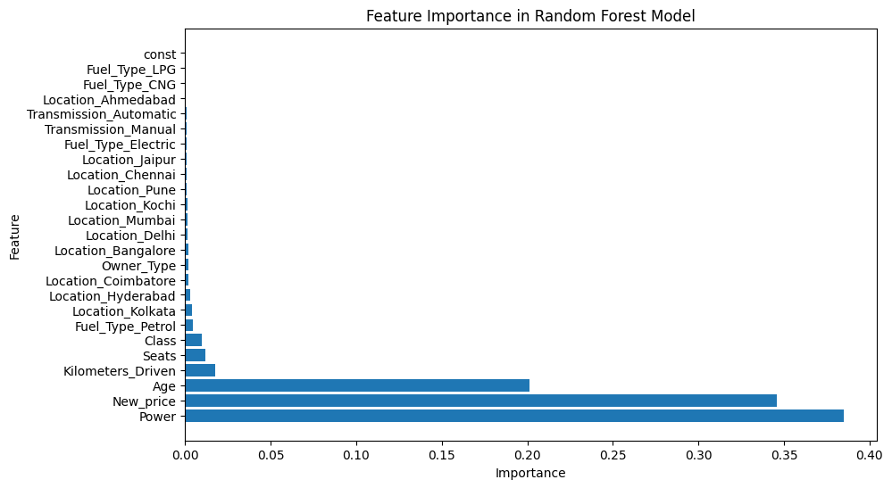
Model Results - Feature Importance

Slide 17
Model Results - Key Takeaways
Dominant Predictors:
Power: Engine power emerges as the most influential factor, accounting for nearly 39% of the feature importance. This suggests that buyers in the used car market place a high value on performance and engine capabilities.
New Price: The original price of the car is the second most crucial factor, explaining about 34% of the variance. This highlights the strong anchoring effect of the original price on the used car market.
Age: The car's age contributes around 20% to the prediction, confirming the expected depreciation of value over time.

Slide 18
Model Results - Key Takeaways
Secondary Factors:
To a lesser degree, the Number of Seats (i.e. size of the car) and Class help increase the price and therefore profits.
Certain markets such as Hyderabad, Bangalore, Coimbatore tend to sell at a higher prices.
Kilometers Driven tends to lower the value of a car. We should develop sales strategies to lower the number of highly driven vehicles on our lots.
The Kolkata market tends to sell at lower prices. We should use caution expanding the business in this market without carefully weighing the profit margins.

Slide 19
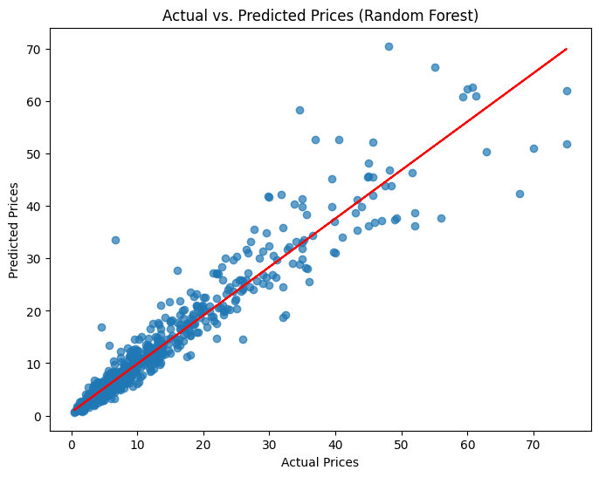
Model Results - Predictive Power

Slide 20

04
Recommendations
Insights and Business Focus

Slide 21

Insights - Business Focus
Significant Predictors: In pretty much all our modeling, the most relevant features that affect the price of a used car are New Price, Age and Power.
The sales organization should emphasize these features while negotiating with customers.
Focus on maximizing inventory based on these factors by acquiring newer higher end, more powerful cars.

Slide 22
Business Focus - Secondary Factors
The Number of Seats (i.e. size of the car) and Class of Car help increase the price and therefore profits.
Kilometers Driven tends to lower the value of a car. We should focus on acquiring fewer highly driven vehicles - especially on the lower end.
Certain markets such as Hyderabad, Bangalore, Coimbatore tend to sell at higher prices.
The Kolkata market tends to sell at lower prices. We should use caution expanding the business in this market without carefully weighing the profit margins.

Slide 23
Business Focus - Risks
Alternative Energy Vehicles: We have very little data for Electric, CNG and LNP cars. If we determine there is a shift into these or any other emerging markets, we may need to the model accordingly.
Economic Conditions: Inflation, recession, interest rates, fuel prices are only some of the economic factor that change our model’s performance.
Generalized Data: A lot goes into the price of a used car. Certain features that we do not have data for (e.g. Navigation, Sunroof, AWD) can also affect the resale value of a car. Collecting this type of additional data could improve our price prediction.
Missing data: In the models we are comparing above, we imputed a lot of Mileage, Engine, Power, Seat and New_price data and dropped 19% of our data where we had no Price data or New_price data. Exploring ways to eliminate our missing data at the source will likely improve our model’s predictive performance.
Notes:
Remember:
Relative Importance: The importance scores are relative, not absolute. They indicate the importance of each feature in the context of your specific model and dataset.
Correlation vs. Causation: Feature importance does not imply causation. A feature might be important because it's correlated with the target variable, but it might not be the actual cause of the change in the target variable.
Potential Model Enhancements:
New Predictors: It might be necessary to add new predictor variables to the model to capture the impact of specific economic factors (like interest rates or new car production) on used car prices.
Model Retraining: The model should be retrained periodically with fresh data to ensure it remains accurate and reflects the current market conditions.

Slide 24
-Shashank Srivastava, Executive Director, Maruti Suzuki India.
"The future of the Indian car market belongs to the used car segment. It is poised for an exponential growth trajectory."

Slide 25
Questions

Slide 26
Appendix

Slide 27
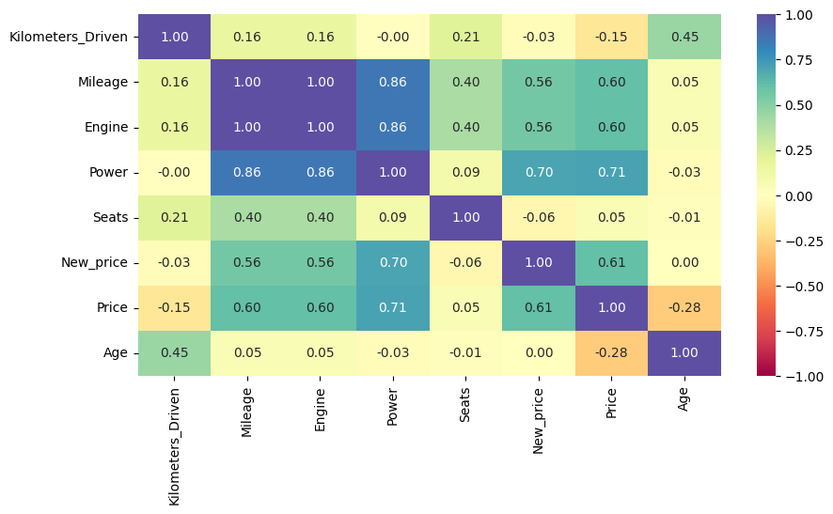
Data Exploration - Numeric Correlations

Slide 28
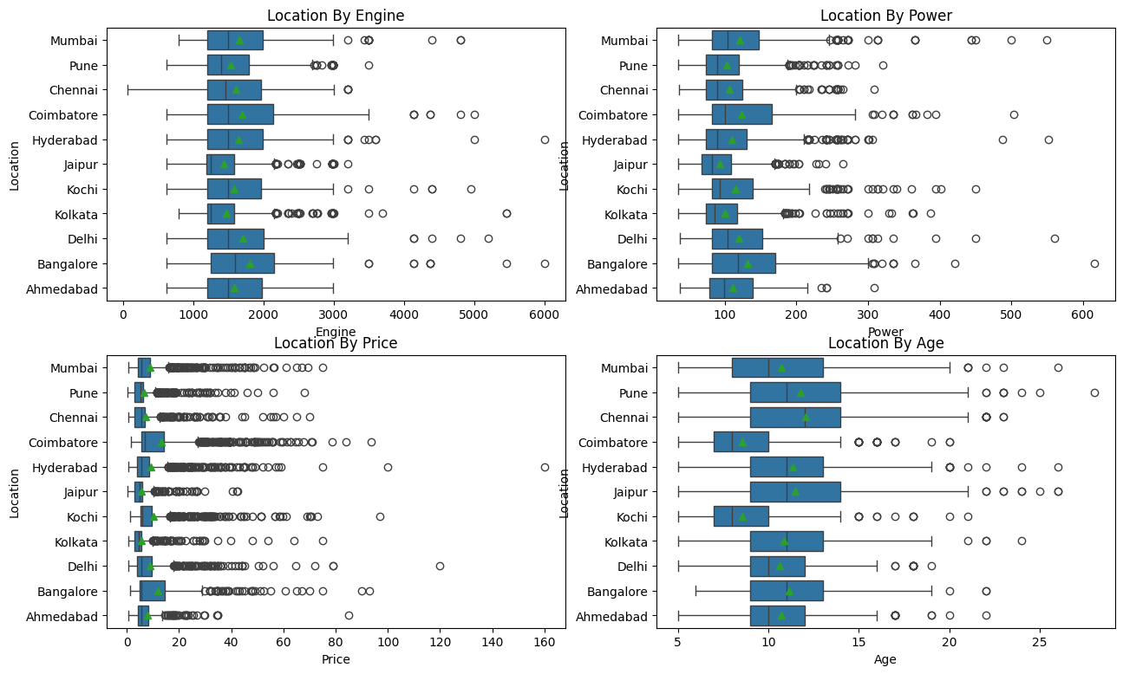
Data Exploration - Locations

Slide 29
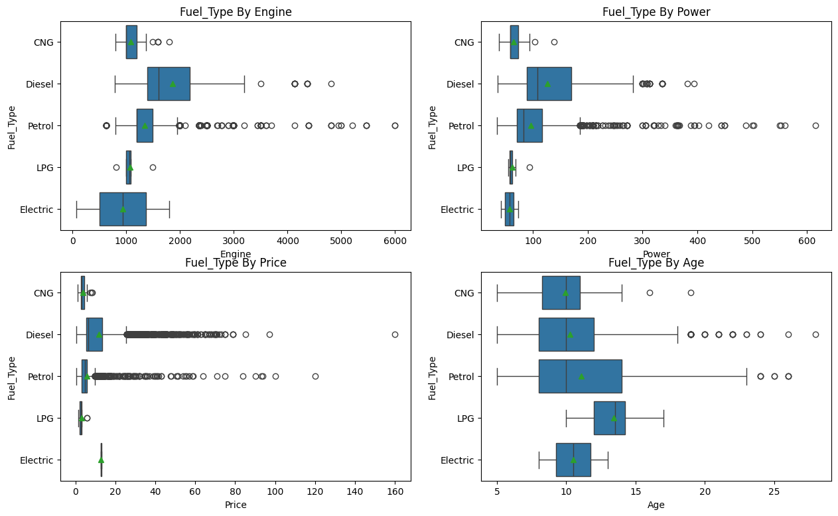
Data Exploration - Fuel Type

Slide 30
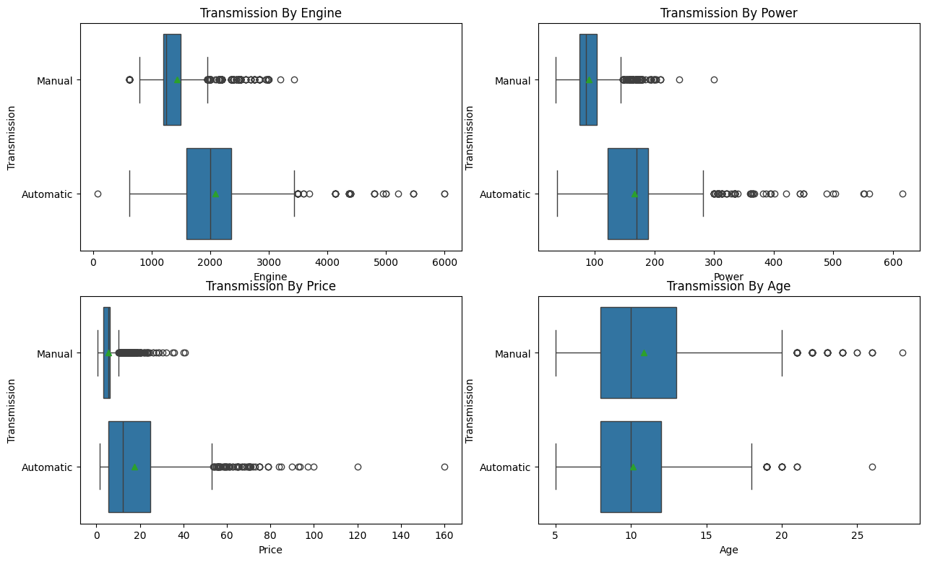
Data Exploration - Transmission

Slide 31
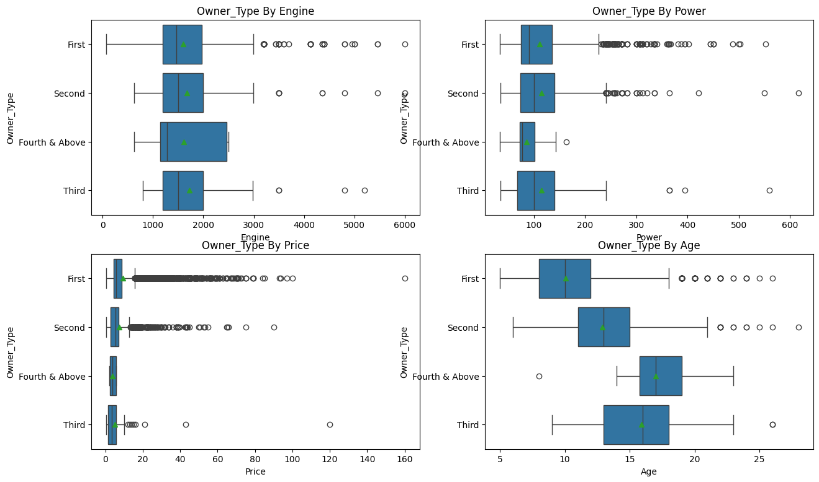
Data Exploration - Owner Type

Slide 32
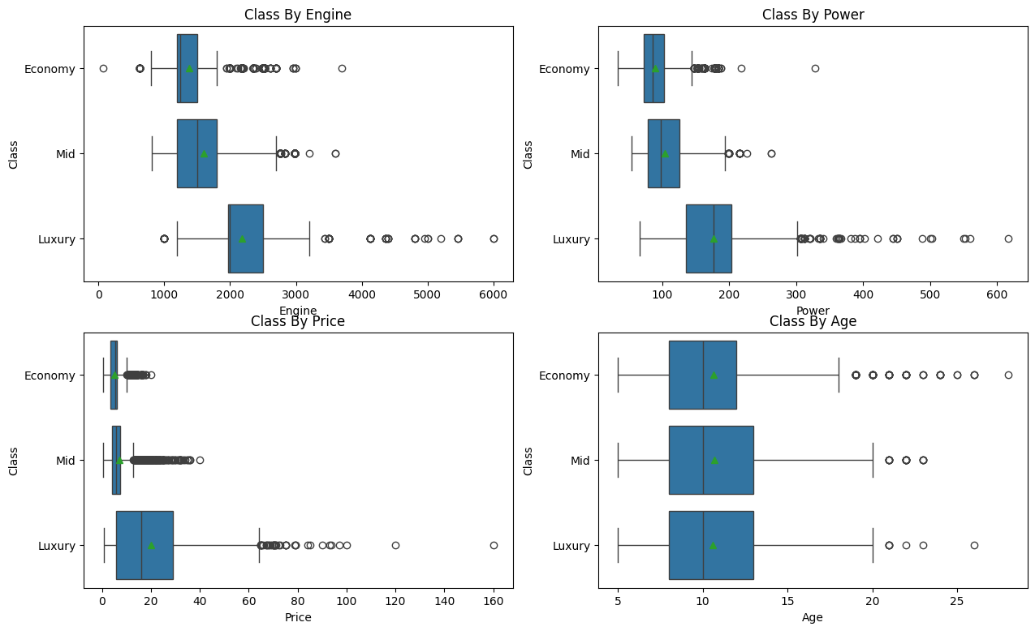
Data Exploration - Class

